Slide 1
API Logging and Monitoring for Security Events
API security is paramount in today's digital world. This presentation explores the critical role of robust API logging and monitoring practices for proactive security.
Guide : Dr. S Radha
Team Members:
Abburi Bhavya Sri (21R11A05A5)
Kosuru Bharath Kumar (21R11A05C8)

Slide 2

Abstract
1
API Security Landscape
2
Focus on Logging and Monitoring
APIs serve as the communication backbone for modern applications, making them a key attack surface.
This presentation delves into creating a comprehensive framework for API security through advanced logging and real-time monitoring.
3
Objective: Proactive Security
4
Alignment with SIEM
The goal is to implement robust systems for detecting, analyzing, and responding to API security events in real-time.
The approach aligns with modern security information and event management (SIEM) practices, ensuring a holistic security posture.

Slide 3
Literature Survey Overview
IEEE paper - Designing Robust API Monitoring Solutions
OWASP API Security Top 10 Analysis
API Security 101: Insufficient Logging and Monitoring
Access Logs and Issues in one page

Slide 4
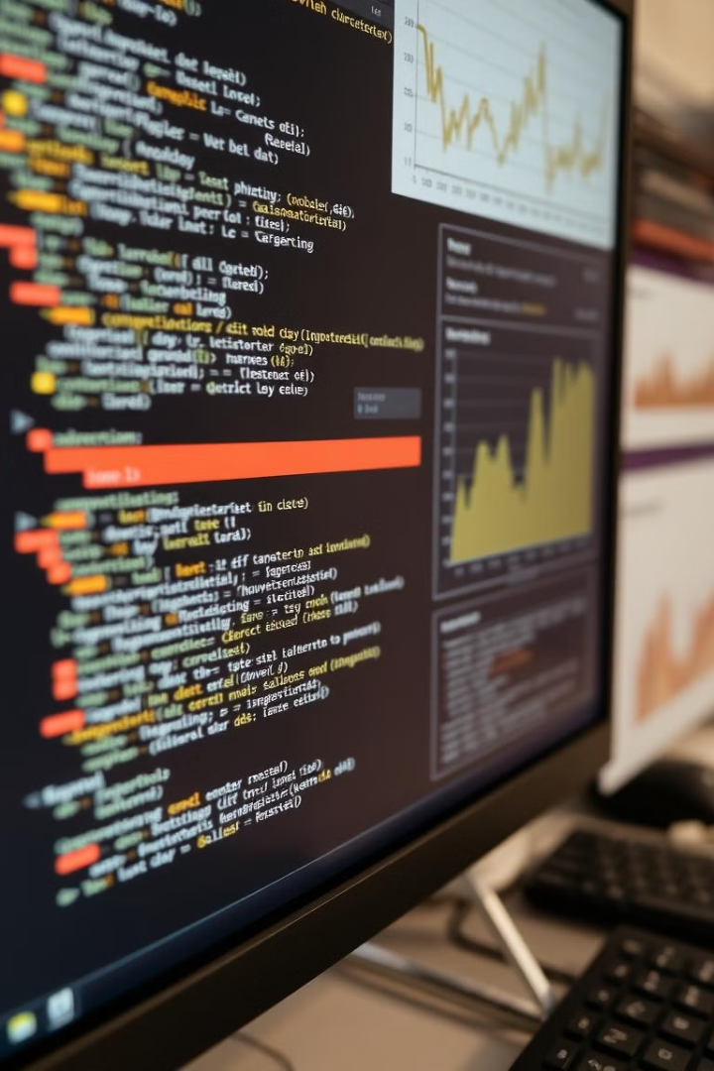
Research 1 – IEEE Paper
SNIPER Framework
Addressing Challenges
SNIPER leverages dynamic binary instrumentation and hardware-assisted virtualization for precise API monitoring.
The IEEE paper addresses challenges like incomplete data and instrumentation artifacts, ensuring data integrity.
Focus on Accuracy
SNIPER aims to achieve high accuracy, recall, and transparency, providing comprehensive insights into API behavior.

Slide 5




Research 2 – OWASP API Top 10 Analysis
OWASP Coverage Gaps
The analysis points out gaps in OWASP's coverage, such as the lack of guidance on injection attacks.
Emerging Threats
Emerging threats like mass assignment are identified as crucial areas for proactive security measures.
Shifting Security Left
The blog post emphasizes the importance of integrating security considerations early in the development lifecycle.

Slide 6
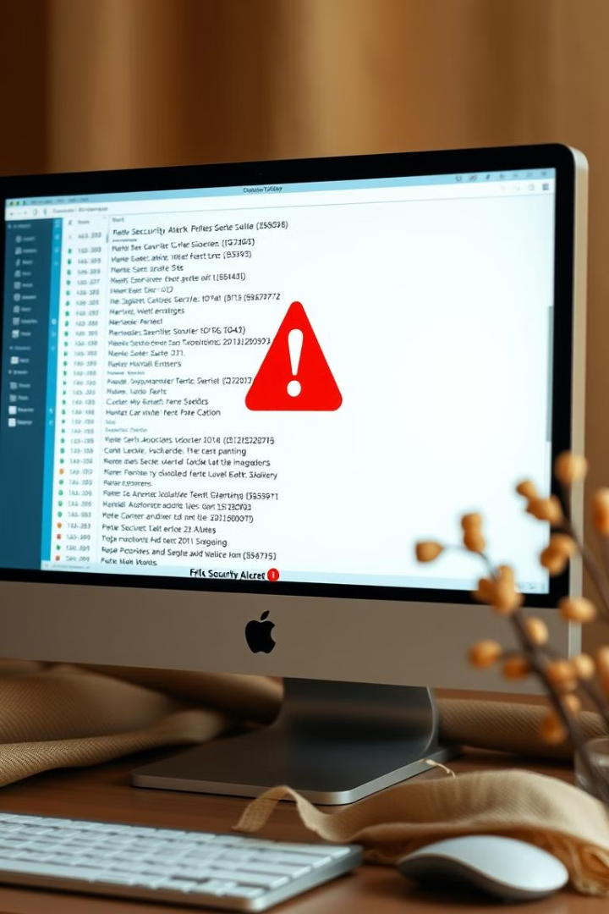
Research 3 – Insufficient Logging and Monitoring
Importance of Logging
Capture API-specific events, such as authentication failures and sensitive operations.
Real-Time Alerts
Implement real-time alert systems to detect malicious activity quickly.
Example Scenarios
Identify brute-force attacks and prolonged unauthorized access through logging and monitoring.

Slide 7
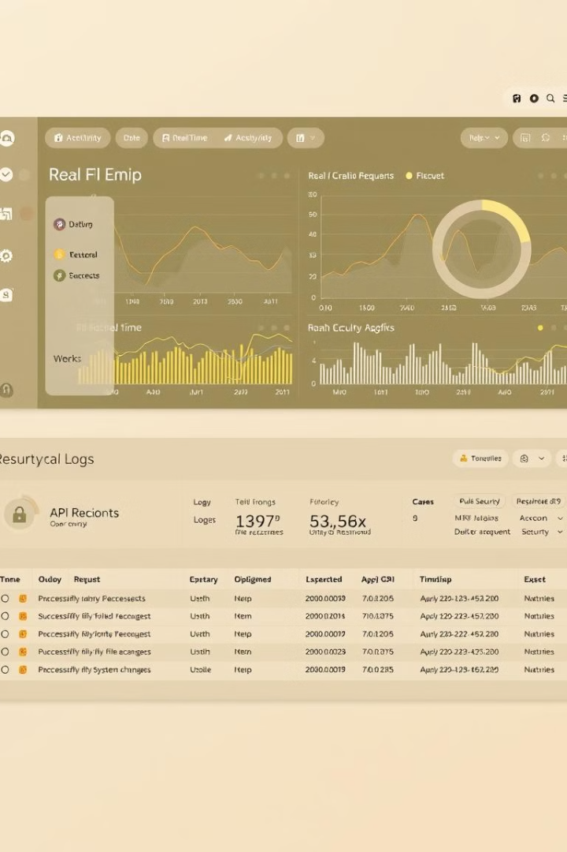
Research 4 – Real-Time Monitoring and Logging
1
Combined Approach
Real-time monitoring enhances security by combining historical logs with continuous data analysis.
2
DDoS and Brute-Force Detection
The blog provides practical examples of detecting DDoS and brute-force attacks using combined logging and monitoring.
3
Tools for Scalability
Tools like Knit provide unified views of logs and data, enabling comprehensive analysis and incident response.

Slide 8
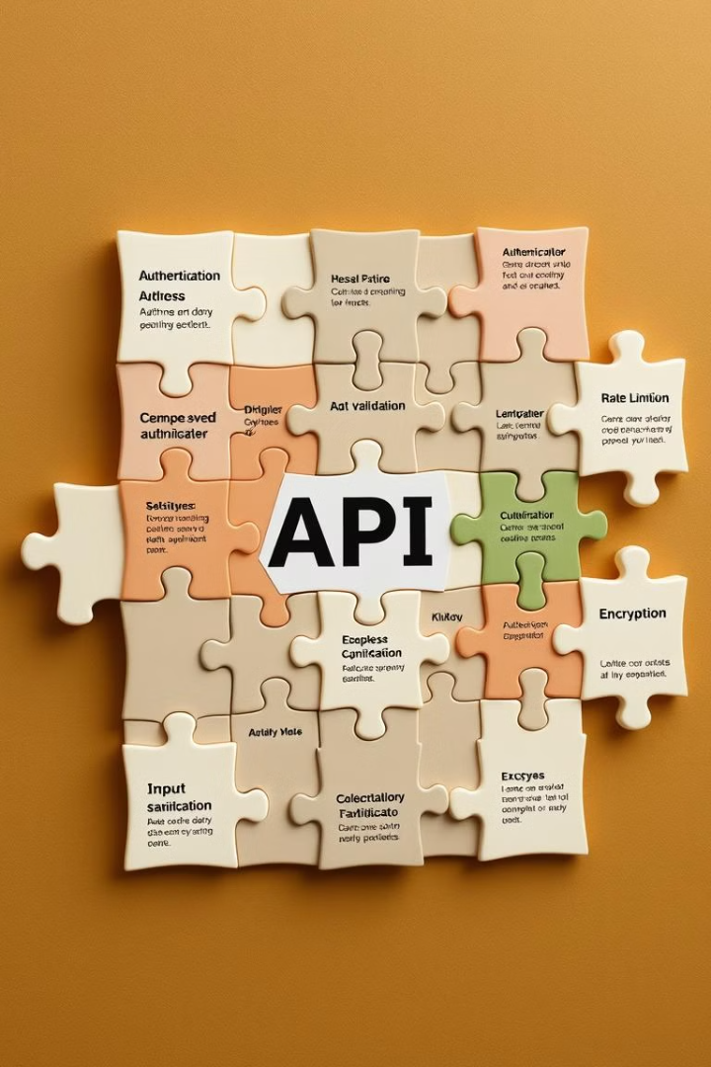




Consolidated Findings
Advanced Monitoring
Vulnerability Awareness
Utilize sophisticated frameworks like SNIPER for comprehensive and accurate API monitoring.
Address emerging threats like injection attacks and mass assignment, ensuring a robust security posture.
Proactive Security
Leveraging Tools
Implement real-time monitoring in tandem with detailed logging for proactive security measures.
Select tools that provide scalability, usability, and effective incident response capabilities.

Slide 9
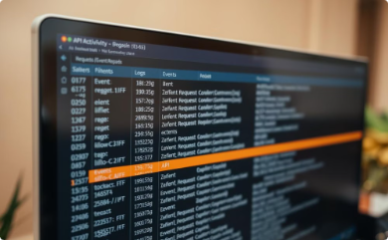
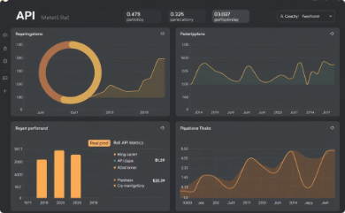
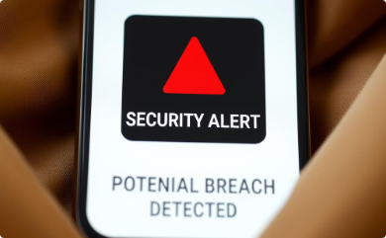

Implementation Plan
Baseline Logging
Real-Time Monitoring
Alerting Mechanisms
Periodic Evaluation
Establish a baseline for normal API behavior through comprehensive logging of API activity.
Integrate tools like Prometheus and Grafana for real-time monitoring of API performance and security metrics.
Implement robust alerting mechanisms to quickly notify security teams of anomalies or suspicious activity.
Conduct regular evaluations and updates to the logging and monitoring system based on emerging threats and security best practices.

Slide 10

References
https://ieeexplore.ieee.org/document/9645216
https://www.pynt.io/blog/owasp-top-ten-blogs/the-matrix-chronicles-api-security-and-the-battle-for-sufficient-logging-and-monitoring
https://blog.shiftleft.io/api-security-101-insufficient-logging-and-monitoring-87a8e5996e36
https://www.getknit.dev/blog/api-monitoring-and-logging

